Slide 1
NOUNS
Types (person, place, thing, and idea) Proper vs. Common

Slide 2
© Rabbit Hole Learning 2025
This resource is for personal and educational use only.
Not for resale or commercial distribution.
Questions? Feedback? Visit www.rabbitholelearning.org or email me at admin@rabbitholelearning.org

Slide 3

What is a Noun?
It is a word for a person, place, thing, animal, or idea.
Notes:
Today, let's dive into the world of nouns.
So, what exactly is a noun?
A noun is a word that represents a person, place, thing, animal, or even an idea.
Think about it: nouns are fundamental building blocks of our language. They help us label and categorize everything around us, from a child to the Eiffel Tower, or even abstract concepts like love or freedom.
As we move forward, we'll explore specific examples of nouns, including names of people and places. But for now, just remember: nouns are everywhere in our lives!
What nouns can you think of?

Slide 4
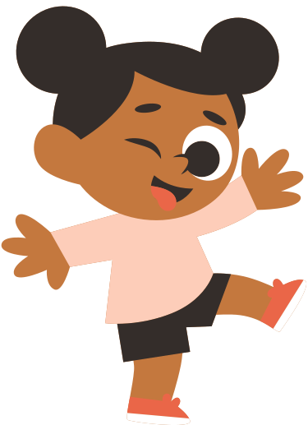

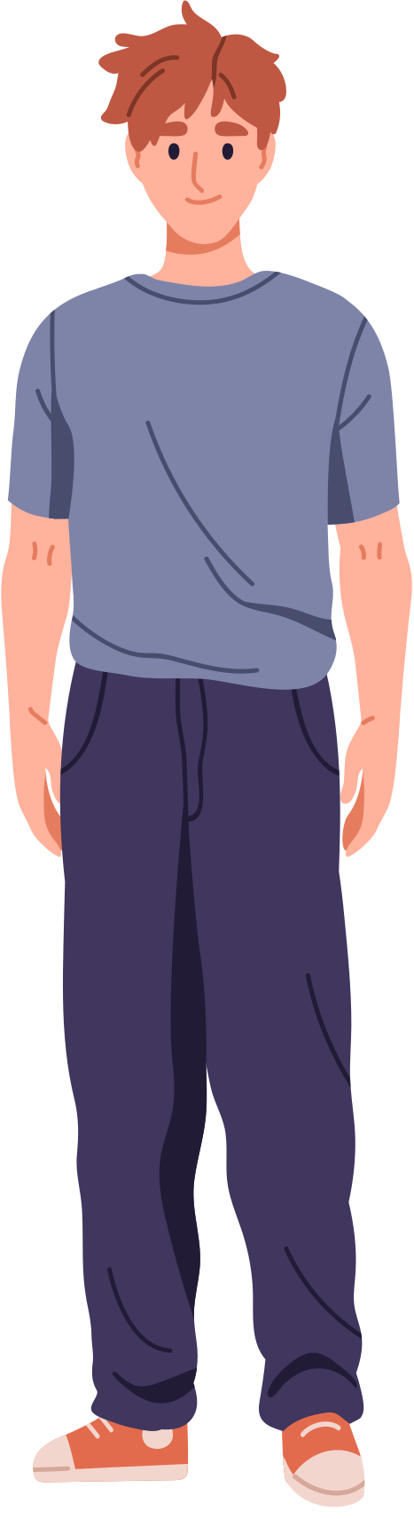
A noun is a name of a person
child
doctor
Max
Notes:
Let's dive a bit deeper into the different types of nouns, starting with those that name people.
A noun is essentially a name of a person.
For example, we have:
- "child," which represents any young human.
- "doctor," referring to a medical professional.
- And, of course, "Max," which may be a familiar name for some.
These examples illustrate how nouns help us identify individuals in our conversations and writing.
What other nouns can you think of that are people?

Slide 5



A noun is a name of a place
mountain
Library
Eiffel Tower
Notes:
Now, let's explore another type of nouns.
A noun is also a name of a place.
Think about the locations that are significant in your life.
For example, we have a ‘mountain’ – a majestic natural feature,
or the ‘Eiffel Tower’ – an iconic symbol of Paris.
And let’s not forget the ‘Library,’ a place filled with knowledge and stories.
What are some other nouns that are places?

Slide 6


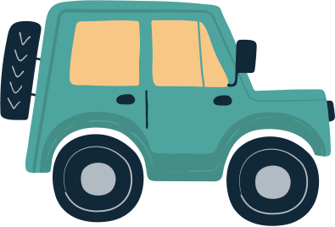
A noun is a name of a thing
book
sunflower
car
Notes:
A noun is a word that names something. It can be something you can touch or see—like a book, a sunflower, or a car. These are all examples of things we can name, and that makes them nouns.”
Can you find five things in this room that are things?

Slide 7
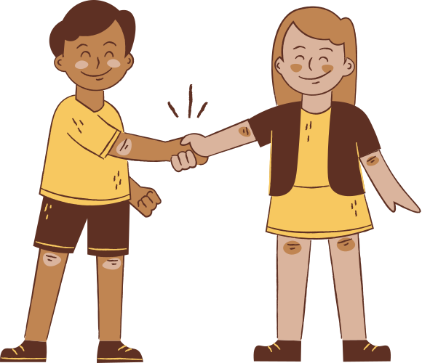
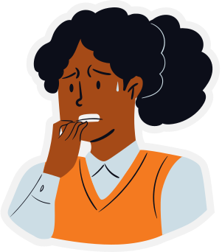
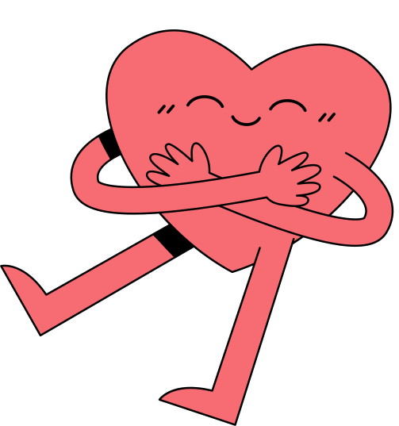
A noun is name of an idea
love
friendship
fear
Notes:
Now, let's explore another important category of nouns.
A noun can also be a name of an idea.
Think about concepts like love, friendship, or even fear.
These nouns are intangible, yet they play a crucial role in our communication and how we connect with one another.
As we continue, keep in mind that nouns aren't just about naming objects or places; they also capture our thoughts and feelings.

Slide 8
ACTIVITY TIME!
Notes:
Now, let's get ready for some hands-on practice!
In our upcoming activity, we're going to find nouns from several sentences.
Remember, you're looking for all types of nouns - people, places, things, and ideas.

Slide 9
Finding Nouns!
Box all the nouns you discover in the sentences.
1. My grandpa bought a pizza for the family.
2. Two elephants crossed the road.
3. I have three pencils and two pens.
4. The states achieved peace without war.
5. Annika has three cats and four dogs.
Notes:
Now that we have a clear understanding of what nouns are, let’s dive into an engaging activity,
We’ll be identifying nouns together!
As you look at the sentences on the screen, I want you to put one of the red boxes around all the nouns you discover.
Let’s start with the first sentence:
"My grandpa bought a pizza for the family."
Think about who or what is being talked about.

Slide 10
Answers!
Box all the nouns you discover in the sentences.
1. My grandpa bought a pizza for the family.
2. Two elephants crossed the road.
3. I have three pencils and two pens.
4. The states achieved peace without war.
5. Annika has three cats and four dogs.

Slide 11


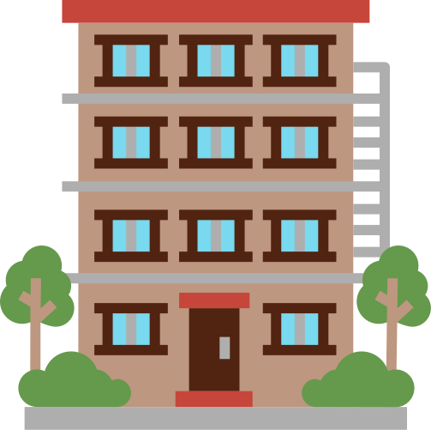


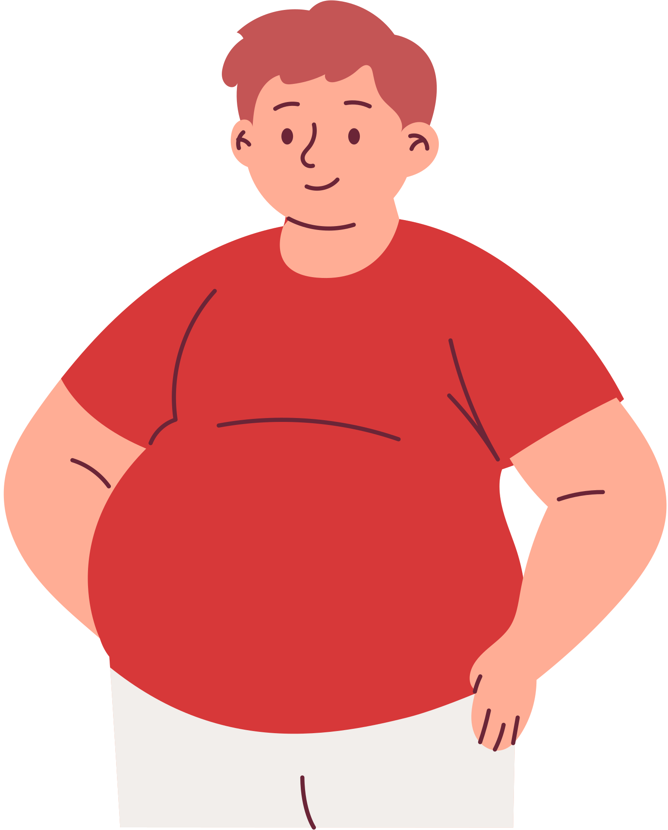
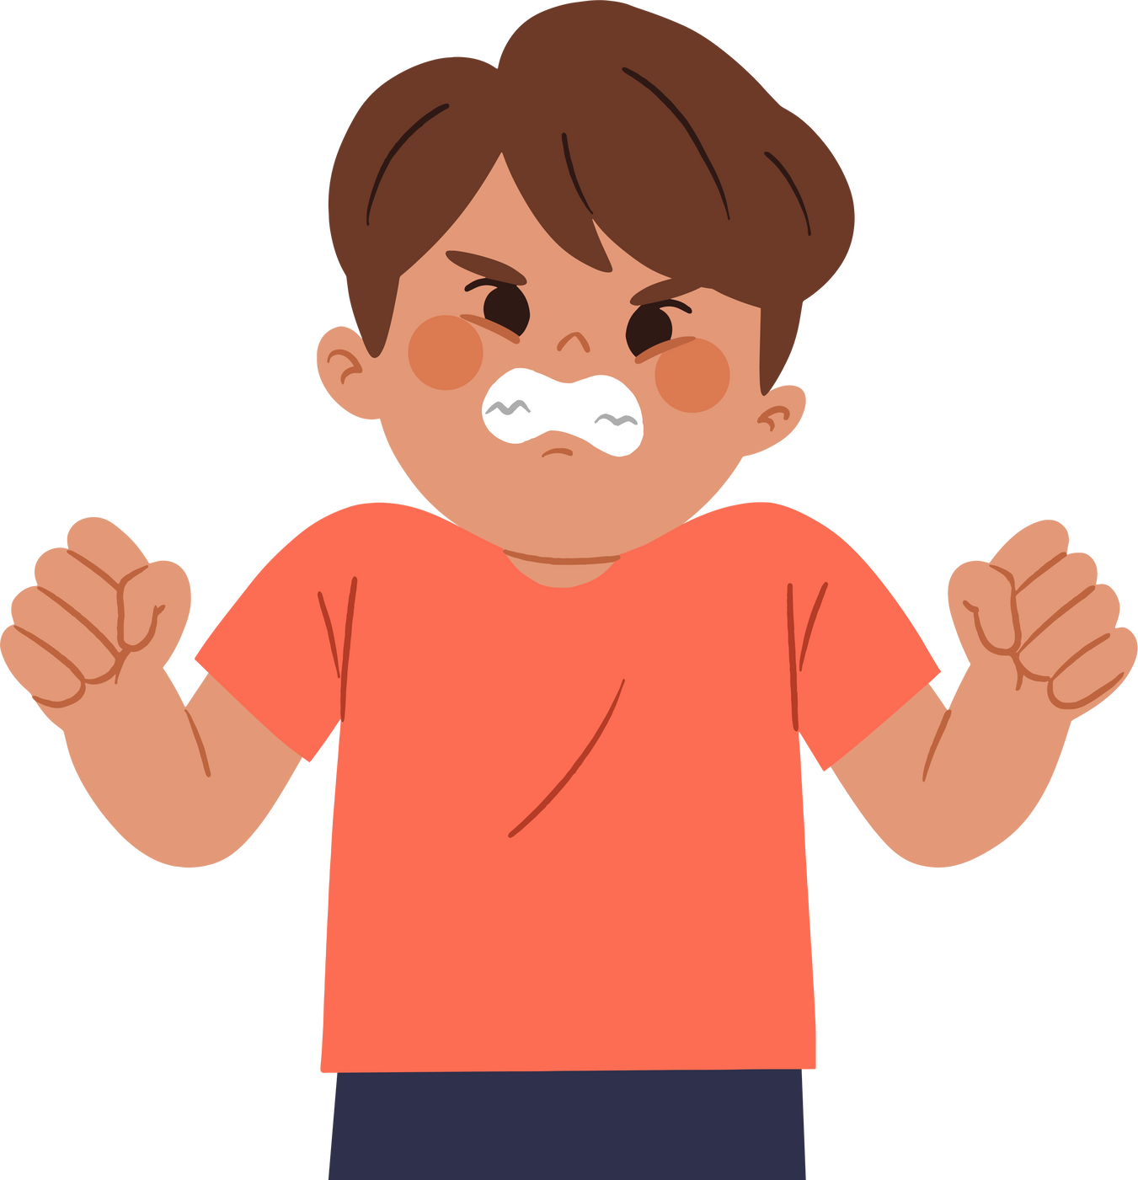
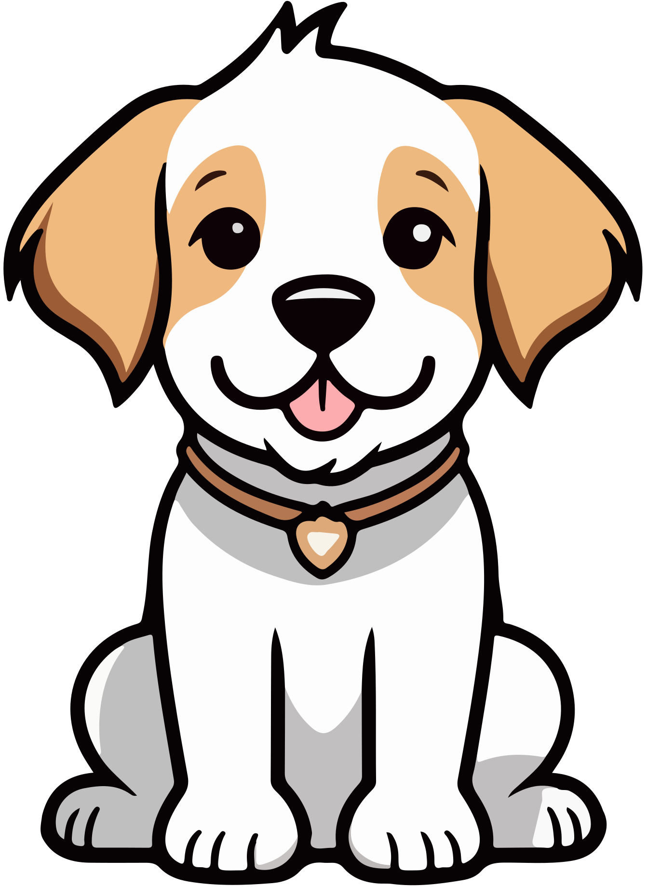
Person
Place
Thing
Idea
Notes:
We’re going to sort these nouns into four categories: person, place, thing, or idea. Some will be easy, some might make you think a little harder!”
For a dog:
“Even though animals aren’t people, we usually sort animals with things—a dog is a thing because it’s not a place, person, or idea. It’s a living thing, but it still fits best in that category.”
For the Statue of Liberty:
“This one can be tricky! It’s a statue, which makes it a thing, but it’s also a place people can go. Either answer could work depending on how you think about it—but for this activity, we’ll sort it as a place because it’s a landmark and people visit it.”
Sometimes words can fit in more than one category—that’s totally okay! What matters is that we can explain why we chose it.”

Slide 12
PART TWO:
COMMON VS. PROPER
Notes:
Now, let's get ready for some hands-on practice!
In our upcoming activity, we're going to find nouns from several sentences.
Remember, you're looking for all types of nouns - people, places, things, and ideas.

Slide 13
What is a Common Noun?
A common noun is a general name for a person, place, or thing.
It does not start with a capital letter
(unless it’s at the beginning of a sentence).
Notes:
A common noun is a word that names something, but not in a specific way. It’s just a general name—like girl, instead of Emma; or city, instead of Paris. Common nouns name everyday things, but not with a proper name.
Common nouns don’t get capital letters unless they’re at the beginning of a sentence. They’re the regular words we use to talk about people, places, things, and ideas in general.
What common nouns can you think of?

Slide 14



Common Nouns
cat
girl
lake
Notes:
Now, let's explore another important category of nouns.
A noun can also be a name of an idea.
Think about concepts like love, friendship, or even fear.
These nouns are intangible, yet they play a crucial role in our communication and how we connect with one another.
As we continue, keep in mind that nouns aren't just about naming objects or places; they also capture our thoughts and feelings.

Slide 15
What is a
Proper Noun?
A proper noun is the specific name of a person, place, or thing.
They ALWAYS start with a capital letter.
Notes:
A proper noun is a special, specific name. It’s not just a city—it’s Paris. Not just a girl—it’s Emma. Proper nouns are the names we give to one unique person, place, or thing, and we always start them with a capital letter.”
If it’s the name of something or someone, like Star Wars or Grandma Sarah, it’s a proper noun. We’re learning to spot when something is a specific name, not just any person or thing.”
What nouns can you think of?

Slide 16
Proper Nouns
Mr. Bubbles
Fatima
Lake Meade
Notes:
Now that we understand what a proper noun is, let's look at some examples together.
Did you notice these are the same pictures as with the common nouns? But now they have different names!
This isn't just a cat, it's Mr. Bubbles!
This isn't just a girl, it's a girl named Fatima
This isn't just a lake its Lake Meade.

Slide 17
WHAT ABOUT WORDS
LIKE MOM OR DAD?

Slide 18
Words like mom and dad can be common nouns or proper nouns it depends on how we use them!
Common noun (not capitalized):
My mom is reading a book.
Proper noun (capitalized):
I’m going with Mom to the store.
Notes:
Words like mom, dad, grandma, and aunt can be tricky. Sometimes they’re general words—that makes them common nouns. But if you're using them like a name, like you would say Mom instead of Linda, then it’s a proper noun, and it gets a capital letter.”
Try this test: Can you say a name in its place? If you can say Linda instead of Mom, then it’s a proper noun.”

Slide 19
ACTIVITY TIME!

Slide 20
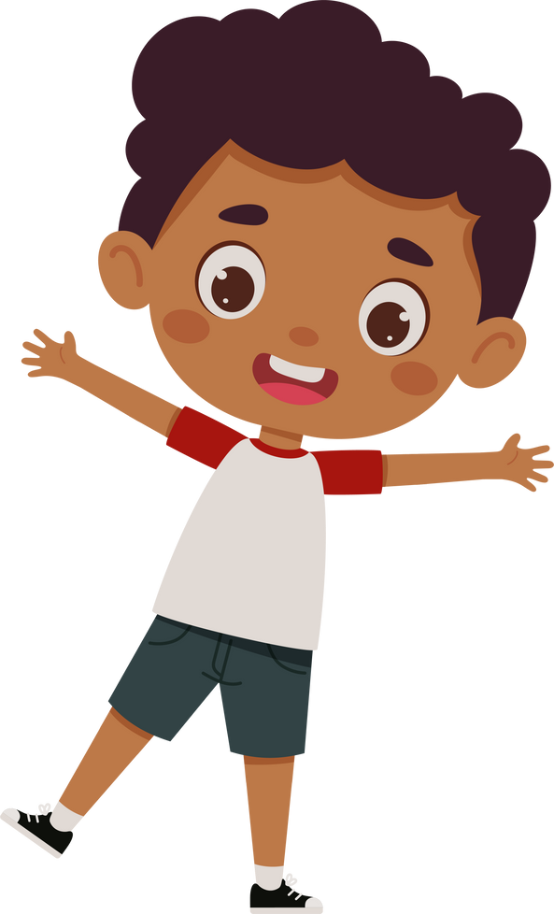


Look at each picture and replace the words Common and Proper with real nouns that match the picture!
Common
Proper
Common
Proper
Common
Proper
Notes:
As you can see on the slide, we have several images in front of us. Your task is to look at each picture and think about how we can replace the words "Common" and "Proper" with actual nouns that fit what you see.
This exercise will help reinforce our understanding of common and proper nouns in a fun way.
Remember, a common noun is a general name for a person, place, or thing, while a proper noun is a specific name and should always be capitalized.
I want you to think creatively! Let’s see how many different nouns you can come up with for each picture.

Slide 21
THANK YOU!

